Slide 1
Gosu for Integration
April 20, 2014
Notes:
Guidewire training materials contain Guidewire proprietary information that is subject to confidentiality and non-disclosure agreements. You agree to use the information in this manual solely for the purpose of training to implement Guidewire software solutions. You also agree not to disclose the information in this manual to third parties or copy this manual without prior written consent from Guidewire. Guidewire training may be given only by Guidewire employees or certified Guidewire partners under the appropriate agreement with Guidewire.

Slide 2
Describe the places where an integration developer uses Gosu
Create Gosu classes
Use blocks as input parameters
Generate unique, sequential numbers

Slide 3
Overview of Gosu for integration
Gosu classes
Blocks
Sequential numbers

Slide 4


Review: Guidewire Gosu
Guidewire's programming language
Similar to Java and compatible with Java
Has elements of both procedural and object-oriented programming languages
Executes fundamental application behavior
Manages complex business processes
Executes hierarchical business rules
Specifies dynamic user interface behavior
Notes:
Gosu is Guidewire’s open-source, publicly available programming language. Gosu has elements of both procedural and object-oriented programming languages and is similar to JavaScript and Java. Guidewire developed Gosu for several reasons. First, there was a desire to have a single syntax that could be used to work with all of the elements relevant to Guidewire products (such as entities, display keys, classes, class enhancements, Java classes, permissions, and script parameters) even though these items have fundamentally distinct internal implementations. There was no existing language that provided this ability. Second, there was a desire to have code auto-complete features in Studio. This is possible only with a statically typed language. Most scripting languages, such as JavaScript, Perl, Python, and Ruby, are dynamically typed.
Prior to ClaimCenter 6.0, PolicyCenter 4.0, and BillingCenter 3.0, Gosu was known as GScript.

Slide 5
Where is Gosu used for integration? (1)
Predefined plugins
Executes fundamental application behavior, such as authentication
Startable plugins
Specifies how to listen for incoming messages initiated by external systems and how to reply to them
Messaging plugins
Asynchronously sends messages and processes acknowledgements
Messaging
Event Fired rules
Creates messages and generates payloads

Slide 6
Where is Gosu used for integration? (2)
Batch processes
Specifies logic to run on a periodic basis
Web services
Specifies methods made available to external applications for synchronous web service calls
Integration logic triggers include:
Non-messaging business rules
PCF actions (such as button clicks)
Workflows
WS-I
Notes:
Workflows execute processes whose execution is time based and/or triggered by events in external applications. Workflows are available in all three primary Guidewire applications. They are used extensively in PolicyCenter to manage policy transactions (such as renewals), and in BillingCenter to manage account delinquency and agency bill cycles. The feature is available in ClaimCenter, and the base application provides one workflow for metropolitan report integration. This workflow is not enabled in the base application, but it can be enabled via config.xml.

Slide 7
Gosu features and benefits
Code is more compact
Direct access to Guidewire data model
Development time is shorter
Reload Classes or Make Project
Guidewire Studio supports Gosu coding
Code completion
Syntax checking
Navigable links
Robust interaction with Java
Easy to learn by Java programmers
Has access to all Java types and can reference Java classes
Notes:
Gosu is based on the ECMAScript language standard. Gosu provides a unified type model that lets types from extremely different sources such as database entities, Java types, and user interface elements interact together seamlessly. Gosu has a rich object-oriented programming feature set that includes classes, interfaces, and polymorphism.

Slide 8
Gosu skills fundamental for integration
Integration points involve these skills:
Creating and modifying classes, including:
Declaring and referencing properties and methods
Extending classes
Creating and implementing interfaces
Using blocks as input parameters
Generating unique or sequential numbers
Writing queries to retrieve data from the Guidewire database
Manually committing data to the database
Using existing Java types and classes
Notes:
This lesson discusses Gosu classes, blocks, and unique, sequential numbers.

Slide 9
Additional Gosu features
Advanced object-oriented design
Enums
Generics
Custom annotations
Numeric literals
Intervals
Null-safe operators
Data transformation
XmlElement class to import, modify, and/or export XML
Typecode mapper maps Guidewire typecodes to external system typecodes and vice versa
Testing
Entity builders
GUnit tests

Slide 10
Overview of Gosu for integration
Gosu classes
Blocks
Sequential numbers

Slide 11
Gosu classes
Gosu classes are similar to classes in other object-oriented language, such as Java
Classes are organized in packages
Classes can define:
Constructors
Properties (with private and public access)
Methods (with private and public access)
Classes can:
Extend other classes
Implement interfaces
Override methods
Notes:
There are some minor variations between the terminology used for Gosu classes and Java classes.
Java term Gosu term
Method Method (declared using the key word "function", so there are times they are also referred to as functions)
Field Variable
Property No direct equivalent, though manipulation of the variable's values may be done through get() and set() methods
Constructor Constructor (declared using the key word "construct", so there are time this is also referenced as a construct() method)

Slide 12
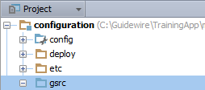
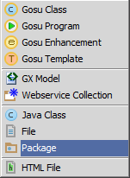
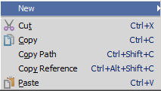
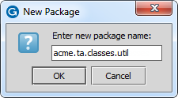
Step 1: [Optional] Create a package
In Project View, select gsrc or an exisitng package in …\configuration\gsrc\
Context menu → New → Package
Enter the package name
Use dot notation to create a package hierarchy
<company>.<app_code>.mechanism.<functional_area>
Notes:
In the slide example, the package reference is for illustration purposes and does not exist in TrainingApp. In the slide example, the dot notation creates a package hiearchy of four packages: acme, ta, classes, and util. Packages are always arranged in a hierarchy. When naming a package, the package name must be unique for the given parent package or \gsrc folder. Package names should be entirely lower case. Do not create child packages in com.guidewire or gw packages.
<company> is the company's name or a suitable abbreviation.
<app-abbrv> is the Guidewire application's two-letter abbreviation, for example PolicyCenter is pc, BillingCenter is bc, ClaimCenter is cc, ContactManager is ab or cm.
<mechanism> is often batch, messaging, plugin (for predefined non-messaging, non-startable plugins), startable, webservice, or class(es)
<functional_area> is the functional area of the application.
The naming convention for packages for Gosu classes is:
<company>.<app-abbrv>.<mechanism>.<functional_area>
The naming convention for packages for Java packages is: com.<company>.<app-abbrv>.<mechanism>.<functional_area>
A package is a collection of classes grouped together because they perform related logic, and/or they should have access to each other while classes outside the package should not (though this usage of packages is less common).

Slide 13
Notes:
Recommended naming convention for packages. Package named should be entirely lower case.
Gosu: <company>.<app-abbrv>.<mechanism>.<functional_area>
Java: com.<company>.<app-abbrv>.<mechanism>.<functional_area>
where...
<company> is the company's name or a suitable abbreviation.
<app-abbrv> is the Guidewire application's two-letter abbreviation:
PolicyCenter: pc
BillingCenter: bc
ClaimCenter: cc
ContactManager: cm
TrainingApp: ta
<mechanism> is one of:
batch
messaging
plugin (for predefined (non-messaging, non-startable) plugins)
startable
webservice
class (for any package that isn't covered by one of the above mechanisms)
<functional_area> is the functional area of the application.

Slide 14
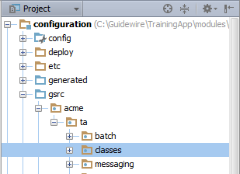
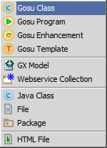
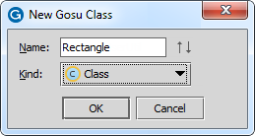
Creating Gosu classes
In Project View, select an exisitng package in …\configuration\gsrc\
Context menu → New → Gosu Class
Use meaningful name with Pascal Case
Capitalize the first letter in the identifier and the first letter of each subsequent concatenated word
Notes:
Object-oriented programming is a programming approach in which developers create classes, which are instructions for how to build a set of objects and the properties and behaviors those objects will have, and create and manipulate individual objects, known as instances of a class or type. Every class is created by a class definition, which specifies
The class name
The properties that every instance of the class has
Methods that every instance of the class has
Just like Java, access to Gosu classes, variables, properties, and methods can be controlled using access keywords: public, protected, internal, private. However, the defaults for Java and Gosu are not the same. In Gosu, the default access for a class is public, the default access for a variable is private, the default access for a property is public, the default access for a method is public, and Java's default access level is known in Gosu as internal.
A constructor is a special method that is executed whenever an instance of that class is created. This method can be used to initialize objects or run any other logic appropriate to the creation of a new instance. In Gosu, the constructor is named construct(). Classes with static methods don't required a constructor and the construct() method is often omitted.
The recommended capitalization convention for Gosu class name is to use Pascal Case. In Pascal Case, the first letter in the identifier and the first letter of each subsequent concatenated word are capitalized.

Slide 15
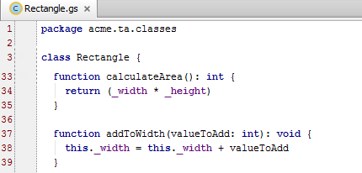
Methods
Methods are declared using the keyword function
Methods can be private or public
Like Java, methods can refer to the instance from which the method is called using the key word this
Notes:
A method is a set of one or more lines of code that can be executed from instances of a class. Similar to properties, methods can also be private which means that they available only to other methods in the defining class.
The recommended capitalization convention for methods is to use Camel Case. In Camel Case, the first letter of an identifier is lowercase and the first letter of each subsequent concatenated word is capitalized. Examples include popupButtonText, calculateAvailability, or assignToNextAvailableUser. Access to Gosu methods can be controlled using access keywords (public, protected, internal, private). However, the defaults for Java and Gosu are not the same. In Gosu, the default access for a method is public.
The "this" keyword refers to the instance of the class from which the method is called. For example, if you had an instance of Rectangle named rectangle17 and you executed rectangle17.addToWidth(3), then the code as shown above on line 38 would logically be equivalent to "rectangle17._width = rectangle17._width + 3".
A method that has input parameters is typically a method that has been abstracted to work in a variety of situations. It is not unusual to see strings, numerics, booleans, and objects as input parameters.
In some situations, a method can be abstracted to work in a variety of situations. But the "value" that varies from each situation is an algorithm or a set of logic. For example, the where() method on an array returns all items in the array that match a given criteria. In this case, it is the criteria that needs to be supplied to the method. Later in this lesson you will see an example using blocks.

Slide 16
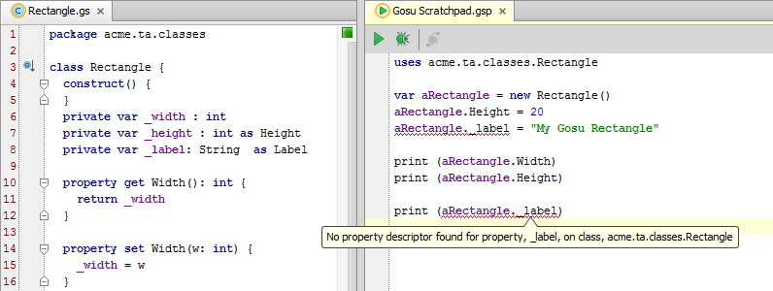
Properties
In Gosu, a property is a private variable whose value is manipulated publicly through getters and setters
Shorthand is to declare the property with the as keyword
private var _label: String as Label
Notes:
A property can be thought of as a value associated with an object. A property has a type and its value can be retrieved or set. There are two approaches to having instance-specific values that can be manipulated:
You can create a field and explicitly set its access to public. This lets any method in any other class access and modify the value. However, this violates the idea of encapsulation and is not recommended.
You can create a private variable that methods of the class can access, but methods of other classes cannot access. Setting the variable to private ensures that only the class's methods are allowed to directly modify the variable's value.
In Gosu, the recommended naming convention is to:
Name private variables with an initial underscore followed by a lower case letter and otherwise using camel case, such as "_aPrivateVariable".
Name a non-public property with an initial capital letter, such as "APublicVariable". (This is unlike Java naming conventions, where properties are "implied" from the get and set methods, and considered to have lowercase names, such as aPublicProperty.)
Just like Java, access to Gosu variables and properties can be controlled using access keywords (public, protected, internal, private). However, the defaults for Java and Gosu are not the same. In Gosu:
The default access for a variable is private.
The default access for a property is public.
Properties can be declared as static. This creates a "class-level" property that is accessible from the class itself. (You can access a static property even when you do not have any instance of the class.)

Slide 17
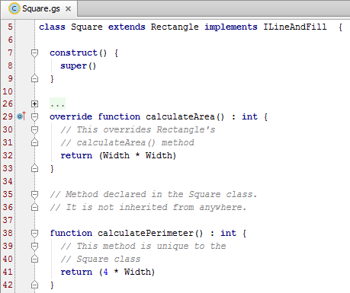
Extending a class
To extend a class
add extends superClass to the class declaration
Super keyword gives you access to aspects of the superclass
Override keyword lets you override methods declared in the super class
Access to inherited properties
As declared in the superclass, the class can access non-private properties and methods
Notes:
When one class extends another, the extending class (Square in the example above) is said to be a subclass of the extended class (Rectangle in the example above). The subclass automatically has access to all non-private properties and methods in the superclass.
The super() method references the method declaration of the parent class. For example, line 6 in the code above identifies that the constructor for Square should use the constructor declared for Rectangle.
The override keyword lets you create an alternate declaration for a method declared in the superclass. For example, lines 9 through 13 in the example above override the Rectangle class's calculateArea() method, which returns "(Height * Width)", with an alternate method: "(Width * Width)".
Subclasses may override individual property accessors (the get() and set() methods used to set property values).
As in Java, Gosu supports the keywords "abstract" (which means you cannot create an instance of the given class and can only create instances of its subclasses) and "final" (which means you cannot further subclass the given class).

Slide 18
Logging
1 package acme.ta.classes
2 …3 uses gw.api.system.PLLoggerCategory
…5 uses org.slf4j.Logger
6 …7 class Rectangle {
…10 protected var logger : Logger = PLLoggerCategory.CONFIG
…54 function enlarge(factor: int): String { 55 if (factor <= 0) { 56 logger.info("Rectangle.enlarge() invalid factor " + factor)
…58 } …63 }
…64 }
Use the slf4j logger and Guidewire static logger category
XXLoggerCategory where XX is code
AB, BC, CC, PC, PL
Always use a logger instead of print() in production code
Notes:
Logging records information about system behavior that is required for diagnostics, trouble-shooting, and failure recovery. Log files contain various types of application messages saved in a separate files. After a log file has been written, you can view a log file. Guidewire logging uses slf4j log severity levels: Trace, Debug, Info, Warn, Error. Each level is considered more severe than the previous.
In the slide example, line 3 and line 5 import the required logging classes. Line 10 creates a logger variable that is available in the package and for subtype classes. The logger is of the type org.slf4j.Logger and uses a static logger category for configuration.
You can check the logging using the is<Level>Enabled() methods on a Logger instance. For example, if there is some overhead associated to the creation of a debug statement's string, check to see if the logging level is at Debug and avoid the construction of the string if this isn't the case.
if (logger.isDebugEnabled() ) { //avoid creating unused strings
msg = String.format("Logging at debug level using object1 %s and %s.", {obj1, obj2})
logger.debug(msg)
}
In a production environment, an administrator is rarely at the console when an important event occurs. For this reason, it is a best practice to always use a logger instead of print() statements. For educational purposes, TrainingApp uses print statements instead of loggers so that students can output information conveniently to the console. Logging is controlled from the logging.properties file in the config/logging directory. The file specifies different categories of logging and the logging level for each category. When a logging statement is encountered that is at or above the specified level, the log message is written to the file. By editing the file, an administrator can control how much and when a Guidewire application writes log files without having to change any application code.

Slide 19
Exception handling
1 package acme.ta.classes
2 …4 uses gw.api.util.DisplayableException
6 7 class Rectangle {
8
…54 function enlarge(factor: int): String { 55 if (factor <= 0) { …57 throw new DisplayableException("Requires a factor greater than 0")
…58 } …63 }
…64 }
Gosu code can throw Gosu and Java exceptions
Gosu also handle catch exceptions with try...catch...finally blocks
Notes:
The try...catch...finally blocks provides a way to handle some or all of the possible errors that may occur in a given block of code during runtime. If errors occur that the code does not handle, Gosu simply provides its normal error message, as if there were no error handling.
The try block contains code where an error can occur, while the catch block contains the code to handle any error that does occur. If an error occurs in the try block, Gosu passes program control to the catch block for processing. The initial value of the error-identifier is the value of the error that occurred in the try block.
If an error is thrown from Java code, the value is the exception or error that was thrown. Otherwise, the value is an exception thrown elsewhere in Gosu code.
If no error occurs, Gosu does not execute the catch block. If the error cannot be handled in the catch block associated with the try block where the error occurred, use the throw statement. The throw statement throws the exception (again) to a higher-level error handler.
After all statements in the try block have been executed and any error handling has occurred in the catch block, the finally block is unconditionally executed.
Gosu executes the code inside the finally block, even if a return statement occurs inside the try or catch blocks, or if an error is thrown from a catch block. Thus, Gosu guarantees that the finally block executes.

Slide 20
Annotation support
1 package acme.ta.classes
2 …4 uses gw.api.util.DisplayableException
6 7 class Rectangle {
8
…50 @Param("factor", "Enlarge shape by this value.")
51 @Returns("A string that compare the original and current areas.")
52 @Throws(DisplayableException, "Displayable exception if the factor is <= 0.")
53 @Deprecated("Don't use Rectangle.enlarge(). Instead, use Shape.enlargeByFactor()") 54 function enlarge(factor: int): String { …63 }
…64 }
An annotation is an expression starting with an @ that provides metadata or implements a coding behavior
Gosu provides annotations for code documentation
Notes:
In the slide example, lines 50-53 illustrates common annotations for methods. Annotations are a simple syntax to add metadata or a behavior to a Gosu class, constructor, method, or property. Use the "at" sign (@), followed by the annotation name, immediately before declarations of what they annotate. Often, an argument list within parentheses follows an annotation. There are four annotations that document basic element behavior:
@Param - Documents a parameter. Must be followed by two arguments: (1) The name of the parameter, (2) The documentation in Javadoc format for the method’s parameter. Used for methods only. It can be used multiple times, typically once for each parameter
@Returns - Documents the return value of a method. Must be followed by one argument: (1) Documentation in Javadoc format for the method’s return value. Used for methods only, and only once per method.
@Throws - Documents an exception that the method can throw. Must be followed by two arguments: (1) An exception type. (2) A description in Javadoc format of the circumstances when it would throw that exception, and how to interpret that exception. Used for methods only. It can be used multiple times, typically once for each exception thrown
@Deprecated - Specifies not to use a class, method, constructor, or property. Must be followed by one argument: (1) A warning string to display if this deprecated class, method, or constructor is used. Used only once for each element.
There are additional annotations exclusive to web services. Annotations on supertypes are inherited by all subtypes. They are directly available via IType reflection on the subtype. Customers can also create custom annotations. Refer to documentation about how to create your own custom annotations.

Slide 21
Overview of Gosu for integration
Gosu classes
Blocks
Sequential numbers

Slide 22
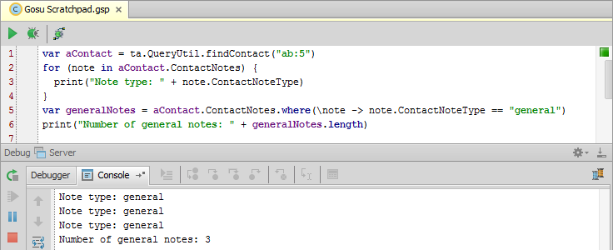
Blocks
A block is an unnamed method that is typically created as an input parameter for another method
For example, an array's where() method takes a block that specifies a certain criteria and returns the elements in the array that match that criteria
Notes:
A block is a method that is not declared using a formal key word (such as "function"), has no name, and is typically never referenced beyond the one time it is created. Blocks contain algorithms or sets of logic, and therefore are ideal for methods that must vary based on a set of statements.
Blocks are sometimes referred to as anonymous functions or lambda (λ) expressions.
Like named functions, blocks can:
Take arguments
Use return
Reference variables from enclosing scopes
Be generic
Unlike named functions, blocks can:
Be an expression
Be passed as an argument to another function for invocation

Slide 23
Block syntax
Syntax: (\argument(s) -> logicToExecute)
var generalNotes = aContact.ContactNotes.where(\note -> note.ContactNoteType == "general")
In most cases, the object is iterable
"note" is a placeholder name for elements from the array
where() method returns all members of the array where the block's Boolean condition is true
Notes:
Type inference makes types in the arguments list optional in some cases. For example, the where() method expects the object to be of type ContactNotes[].
The return type is also inferred from the block body’s expression or return statement. It is never explicitly typed.
References to variables from outer scopes are an important feature:
The block sees the value of a referenced variable as of when the block is invoked, not when defined.
Variables referenced from a block do not go out of scope before the block executes. They are snapshots of the most recent values.
The primary use case for blocks are with methods that require blocks as input parameters. However, you can also use blocks whenever an unnamed function is an appropriate approach to a coding problem.

Slide 24
Overview of Gosu for integration
Gosu classes
Blocks
Sequential numbers

Slide 25
The sequence utility
The sequence utility is a Guidewire class that is used to generate unique, sequential numbers
Useful for business cases requiring numbers that are sequential or unique
Guidewire database stores sequence information
For each sequence, it maintains a record of the last number provided
next() method is used to request numbers
The database provides the next number in the given sequence

Slide 26
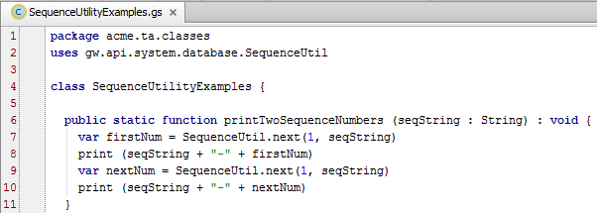
Using the sequence utility
Syntax: gw.api.system.database. SequenceUtil.next(minVal, seqKey)
Notes:
The SequenceUtilityExamples class shown above can be found in TrainingApp in both the trainingapp.demo.gosu and the acme.ta.classes packages.
Syntax notes:
seqKey is the Sequence key. It is a string of up to 26 characters that uniquely identifies the sequence.minVal is the minimum value, of type Long, for the sequence. It specifies the value to use if this is the first request for a number in the specified sequence. On all requests beyond the first one, this value is ignored.The return value is the next number in the sequence and is of datatype long.
When a sequence is started, it will issue the provided minValue as its first value. After that, the returned value is simply the most recently returned value plus one. The next() function is designed to be consistent across different database products.
(continued)

Slide 27
Notes:
On and before the Bedrock platform (ClaimCenter 5.0, PolicyCenter 3.0, and BillingCenter 2.x), next() was a non-blocking method. If it failed to get a value after a set number of tries, then it threw an unchecked exception. The number of tries was configurable. As of the Carbon platform (ClaimCenter 6.0, PolicyCenter 4.0, and BillingCenter 3.0), next() is a blocking method. The Carbon implementation gets an UPDATE lock on the row. This does cause blocking until the lock is acquired, but it results in much faster performance in a multiuser environment and eliminates the problem of exceptions that could occur in the Bedrock implementation when the specified number of retries was exceeded. Behavior on the Diamond platform (ClaimCenter 7.0, PolicyCenter 7.0, and BillingCenter 7.0) is identical to that of the Carbon platform.
Note that if a request for the next sequence value blocks for a long period, due to waiting for the update lock, there may be an exception thrown from elsewhere, such as from the database Connection object. JDBC connection implementations typically throw an exception if no reply is received through the connection after a certain timeout period. Therefore implementations using the SequenceUtil should be prepared for an exception throw from calls to next(). The next() implementation itself will not directly throw a new exception.
The Java API for plugins exposes a similar sequence utility in guidewire.pl.plugin.util package.
The Java and Gosu APIs for plugins expose an entity called Sequence that represents the sequences in the xx_sequence table.

Slide 28
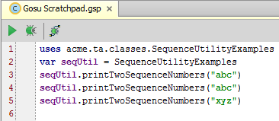
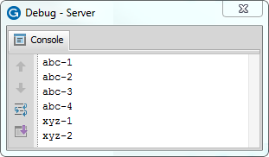
SequenceUtil in action
Gosu Scratchpad
Line 3:
First call "abc"
Line 4:
Second call "abc"
Line 5:
Third call with "xyz"
Call "abc"
Call "abc"
Call "xyz"
Notes:
The screenshots above show a simple example of using SequenceUtil.
The first line of the Gosu Tester code is a call to the printTwoSequenceNumbers() method for a sequence whose key is "abc". In the printTwoSequenceNumbers function, there are two calls to next(). Line 9 is the first call. Because there have been no previous calls for the "abc" sequence, the minimum value of 1 is returned. Line 10 simply prints the sequence key followed by a hyphen and the number returned. On line 11, a second call is made to next(). Because this is not the first call using the "abc" sequence, the minimum value is ignored and the method returns the next number in the sequence. (In this case, it is 2.)
The second line of the Gosu Tester code is a second call to the printTwoSequenceNumbers method for sequence "abc". In the printTwoSequenceNumbers function, lines 9 and 11 call the next() method. Neither of these calls are the first call for sequence "abc", so the next numbers in the sequence (3 and then 4) are returned.
The third line of the Gosu Tester code is a third call to the printTwoSequenceNumbers method. This time, sequence "xyz" is specified. Because this is a new sequence, the first call to next() uses the minimum value of 1, followed by 2.
SequenceUtil reads information from the Guidewire database and writes information to it. Therefore, in order to test SequenceUtil code from Studio:
The application must be running.
Studio must be connected to the application.
If either of these conditions is not true, then calls to SequenceUtil.next() throw a null-pointer exception.

Slide 29
Describe the places where an integration developer uses Gosu
Create Gosu classes
Use blocks as input parameters
Generate unique, sequential numbers

Slide 30
A Gosu class is named Circle. Each instance must have a property for the circle's radius. (This value can be accessed and modified by methods in the Circle class, but not by methods in other classes). How many elements must you create to implement this?
The Circle class extends the Oval class and implements the ICurveLine interface.
Can Circle override methods from Oval?
Can Circle override methods from ICurveLine?
What is the purpose of an annotation?
What types of methods make use of blocks?
(continued)
Notes:
Answers
1) Three. (1) A private variable named _radius. (2) A get() method that retrieves the value of _radius. (3) A set() method that sets the value of _radius.
2a) Yes.
2b) From a keyword standpoint, yes. If Circle implements the ICurveLine interface, then Circle must implement all the methods of the ICurveLine interface using the keyword "override". (However, because ICurveLine is an interface, the Circle class is actually just declaring the implementations of the methods. There are no method implementations in an interface, so there is nothing to "override" from an OOP standpoint.)
3) An annotation provides metadata about the element being annotated.
4) Methods that require logic as input parameters (as opposed to booleans, integers, strings, and/or objects) make use of blocks.

Slide 31
If the only sequence in the database has a key of "abc" and the last number issued for sequence "abc" was 7, what will be the return value of the following:
SequenceUtil.next(1, "abc")
SequenceUtil.next(15, "abc")
SequenceUtil.next(1, "cba")
Notes:
5a) 8 (The sequence has already issued a number (7), so the minimum number is ignored and the next number in the sequence is returned.)
5b) 9 (The sequence has already issued a number (8), so the minimum number is ignored and the next number in the sequence is returned.)
5c) 1 (The sequence is not the "abc" sequence. With no numbers having been issued for the sequence, the minimum value of "1" is returned.)

